Slide 1



Hotel Room Booking
An overview of booking hotel rooms.
prepared by
D. Sai Venkata Krishna-192210328
S. Varshith Reddy-19221o
B.V.S. HarshaVardhana Joshi-192210201
Guided by
Dr. M KATHIRAVAN

Slide 2




Types of Hotel Rooms Available
Suite
Double Room
Master Room
Connecting Rooms
Luxurious and spacious rooms with separate living and sleeping areas
Rooms with two beds, ideal for friends or family
Elegant and premium rooms with enhanced amenities
Rooms with a connecting door, perfect for large groups or families

Slide 3
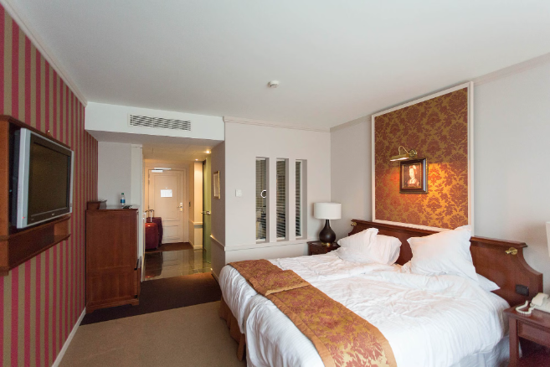
Amenities and Facilities Offered in Hotel Rooms
Modern amenities for convenience:
Flat-screen TV
Mini bar
Complimentary Wi-Fi
Luxurious facilities for comfort:
Plush bedding
Spa-like bathroom
Room service

Slide 4

Factors to consider when booking a hotel room
Location: Is it near attractions or public transportation?
Reviews: Check the hotel's ratings and feedback from previous guests.
Price: Compare rates and consider additional fees.

Slide 5

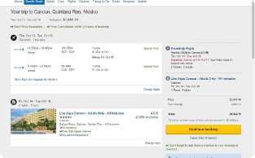
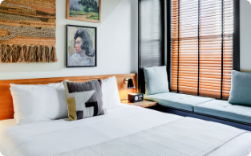

Popular hotel booking platforms
Booking.com
Expedia
Airbnb
Hotels.com
One of the most popular and user-friendly platforms worldwide
Offers a wide range of hotel options and travel packages
Specializes in unique and personalized accommodation experiences
Provides a loyalty program for frequent travelers

Slide 6
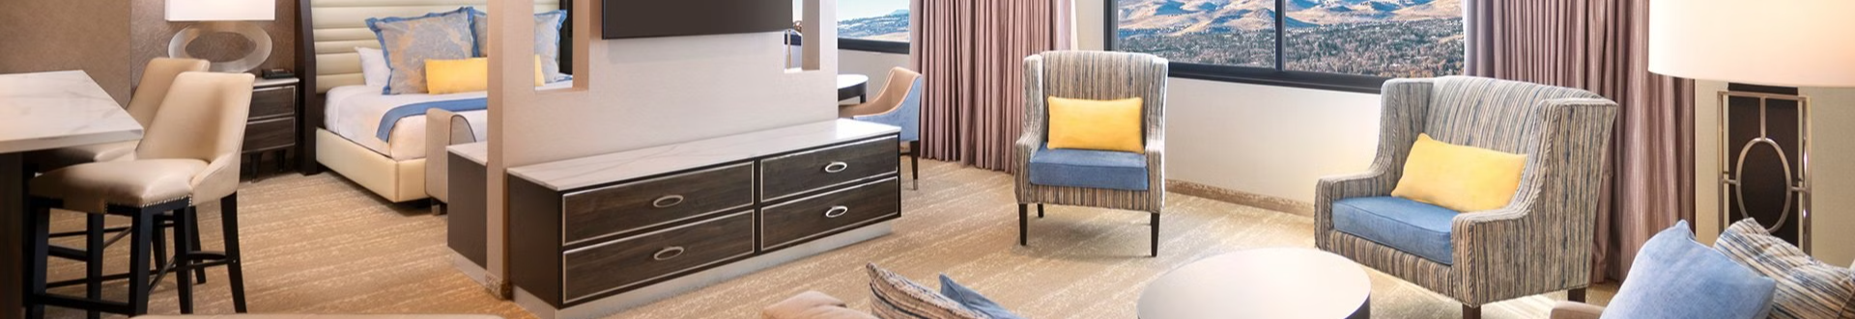



Tips for finding the best hotel room deals
Timing is Key
Be Flexible with Dates
Use Price Comparison Sites
Book during off-peak seasons or midweek for better rates
Consider adjusting your travel dates for lower prices
Compare prices across different platforms for the best deal

Slide 7
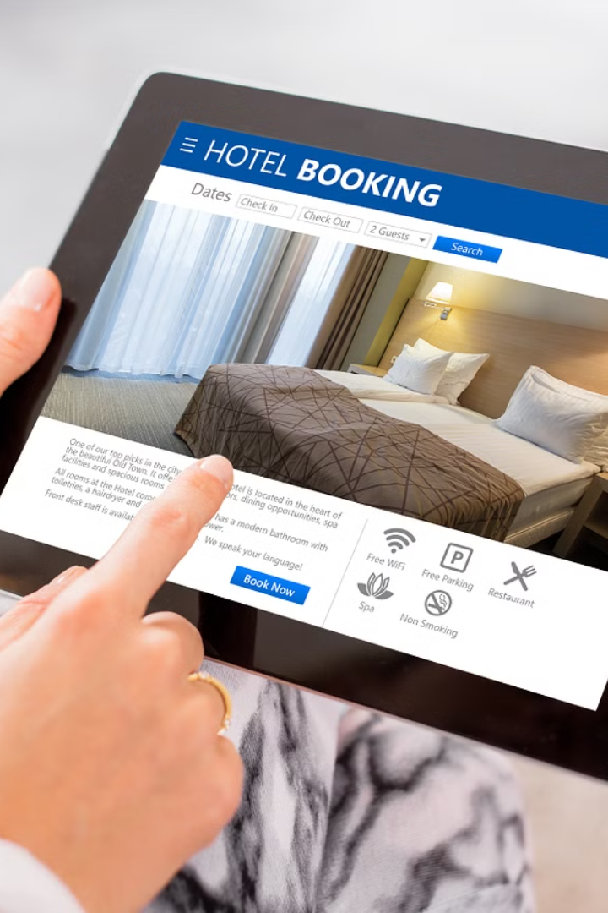
How to Book a Hotel Room Online
1. Visit reputable hotel booking websites.
2. Enter your destination, dates, and preferences.
3. Compare prices and read customer reviews.
4. Select your desired room and book securely online.

Slide 8
Cancellation and Refund Policies
Flexible cancellation policy
Some hotels offer free cancellations up to 24 hours before check-in.
Non-refundable bookings
Be aware of non-refundable bookings which may not offer any refunds.
Refund processing time
Refunds for cancellations can take several business days to process.

Slide 9
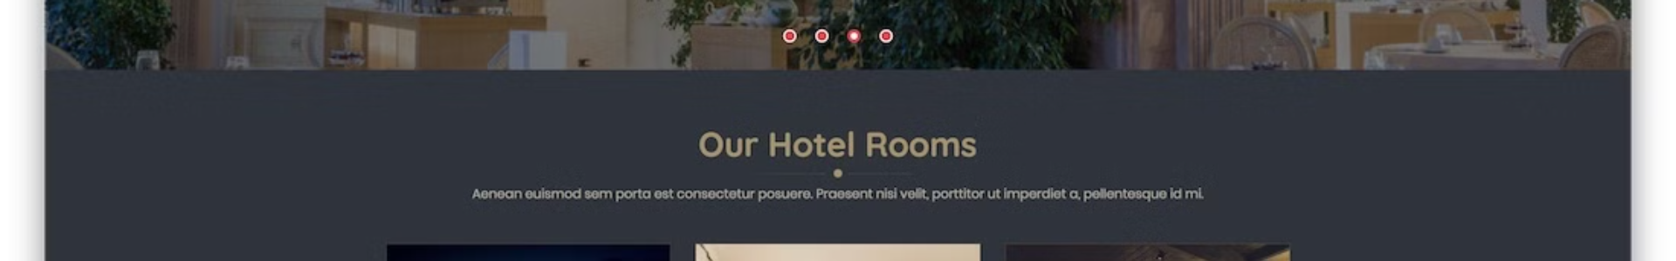
Hotel Website Creation Steps
1
Planning
Determine website goals and target audience. Create a sitemap and define essential features.
2
Design & Development
Develop a visually appealing and user-friendly interface. Ensure seamless integration with booking systems.
3
Testing & Deployment
Thoroughly test the website for functionality and usability. Deploy the website securely.

Slide 10
Conclusion and Final Thoughts
Consider location, reviews, and pricing for best hotel room selection.
Ensure cancellation flexibility and confirm booking details for a hassle-free experience.

Slide 11

Thank You

